Slide 1
Deep Learning for Efficient Discriminative Parsing
Niranjan Balasubramanian
September 2nd, 2015
Slides based on Ronan Collobert’s Paper
and video from here:
http://videolectures.net/aistats2011_collobert_deep/

Slide 2
Motivation
- How far can one go without architecting features?
Feature engineering is difficult.
Adapting to different domains/tasks requires work.

Slide 3
Task Formulations
Parsing as recognizing strings in a grammar.
Parsing as finding the maximum-weighted spanning tree.
Parsing as predicting the sequence of transitions.

Slide 4
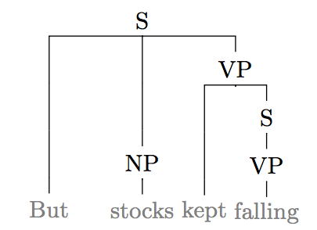
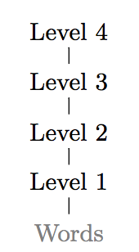
Formulation: High-level Idea
Parse tree is a set of tags at each level.

Slide 5
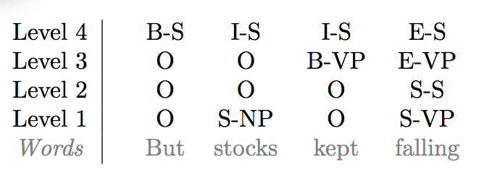
Formulation: High-level Idea
Tags encoded via Inside, Outside, Begin, End, Single scheme.

Slide 6
Formulation: High-level Idea
Task:
Predict the IOBES tag for each word iteratively for starting from level 1
Question:
Will this terminate?

Slide 7
Formulation: High-level Idea
Task:
Predict the IOBES tag for each word iteratively for starting from level 1
Question:
Will this terminate?
No. Although a simple constraint on the tags ensures it does.
Every phrase that overlaps a lower-level phrase must be strictly bigger.

Slide 8
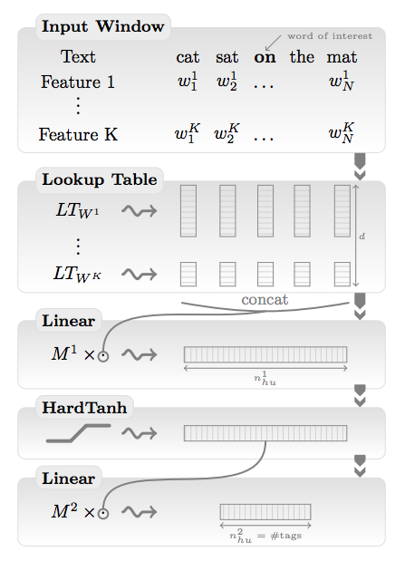
Window Approach
1) Words represented as K features
get embedded into a D dimensional
vector space.
2) Hidden Layer + Non-linearity
3) Linear layer to assign scores for each tag.
Key Issue:
Long range dependencies between words not captured.

Slide 9
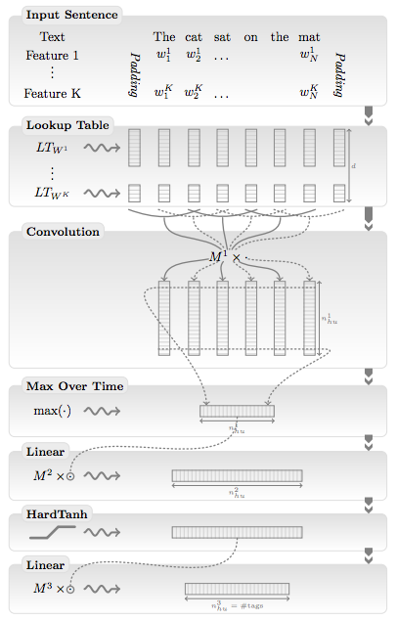
Modeling Long-distance Dependencies: Incorporate Relative Distance
Key Idea:
Combine entire sentence but incorporate relative distance of words.
Add relative distance of the neighboring words to the embedding.
Use a new matrix M¹ to combine the entries from lookup table.
The rest of the architecture remains the same!

Slide 10
Sentence - Convolutional Approach
Key Idea:
For every word that needs to be tagged:
Use a K word sliding window to tile over the entire length of the sentence.
# of tiles = # of words.
For each word convolution produces a fixed D-dimensional representation.
Max over time layer compresses the entire representation to a single D-dimensional vector.
Rest of the architecture is the same.

Slide 11
Structured Prediction
Key Issue:
Still making independent predictions for each word.
Tag for one word should influence the next tag.

Slide 12
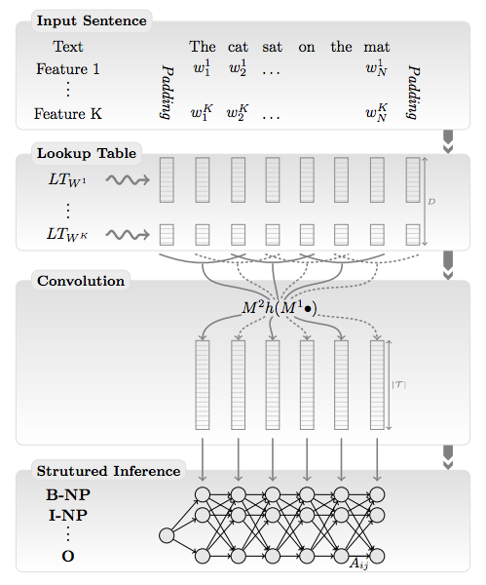
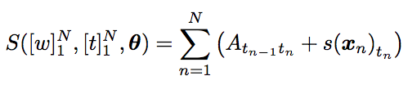

Structured Prediction
Key Idea
Output decisions on words should influence each other.
Treat as a sequence prediction problem.
Learn transition probabilities also as a parameter.

Slide 13
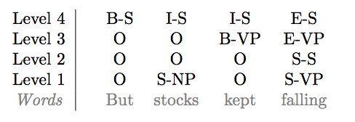
Structure Prediction Constraints: Chunk History and Tree-ness.
Use chunks from previous level
as history.
Only use the largest chunk if there
are many overlapping chunks.
e.g., At level 4 the chunks in history
Would be:
NP for “stocks”
and
VP for “kept falling”
Use the IOBES tags of the chunk words as features.

Slide 14
Structure Prediction Constraints: Chunk History and Tree-ness.
Use chunks from previous level
as history.
Only use the largest chunk if there
are many overlapping chunks.
e.g., At level 4 the chunks in history
Would be:
NP for “stocks”
and
VP for “kept falling”
Use the IOBES tags of the chunk words as features.

Slide 15
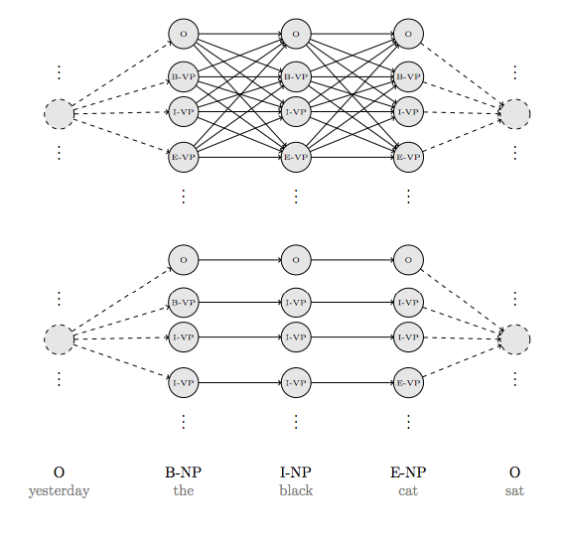
Structure Prediction Constraints: Chunk History and Tree-ness.
Not all paths lead to valid trees.
Simple rules/constraints disallow
invalid trees.
Perform inference on the restricted paths.

Slide 16
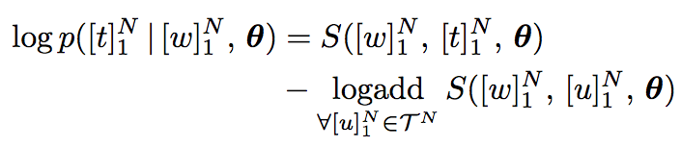

Training: Objective & Optimization
Find parameters that maximize the log-likelihood of data
Log probability of tag sequence given input sequence and parameters (theta):
Logadd component can get exponential in length of the sentence.
A recursive definition (ala inference w/ Viterbi) makes it tractable.

Slide 17
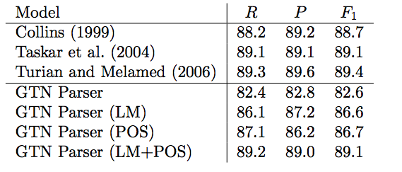
Experimental Results: Is this any good?
Comparable to prior feature based approaches.
Often the case with results in deep learning with NLP.
Benefits more likely when applying to new domain/language.
What next?
Add some of the linguistically motivated features back?

Slide 18
Summary and Issues
A somewhat complicated architecture that accomplishes state-of-the-art results.
Seems to force-fit a naturally recursive model into a CNN.
Recurrent neural networks appear more natural.

